Slide 1



Title: Design and ASIC Implementation of Integrated LFSR–NFSR Based Pseudorandom Generator Using 45 nm Technology
Jeevan R -1DB23EC068
Kushal NS -1DB23EC081
Navyashree S -1DB23EC103
Pallavi Y -1DB23EC108
Under Guidance of
Prof.Sharmila C
Assistant Professor
DEPT. OF ECE, DBIT

Slide 2
PROJECT OVERVIEW & ABSTRACT
ASIC Implementation of Grain-128 Stream Cipher
analytics
PPA Analysis
Rigorous Power, Performance, and Area (PPA) characterization:
Area: 2,375.91 µm²
Power: 324 µW (1.38 mW @ 500 MHz)
Timing: 400–500 MHz (Max)
Throughput: 4.0 Gbps
developer_board
Design & ASIC Flow
Integrated LFSR-NFSR based pseudorandom generator for the Grain-128 stream cipher.
Synthesized using 45nm NanGate standard-cell technology.
Complete open-source RTL-to-GDSII digital flow.
Utilized toolchain including Yosys, OpenROAD, and OpenSTA.
bolt
Key Architecture
Implementation of an 8-bit parallel combinational unrolling technique to resolve throughput limitations.
Achieves high-speed processing suitable for IoT needs.
Boosts performance without causing a proportional area penalty.
Tailored for resource-constrained edge-computing devices.

Slide 3
OBJECTIVES
Key goals and milestones for the Grain-128 ASIC implementation
01
Design & Implement: Create the Grain-128 stream cipher architecture utilizing a combined LFSR-NFSR hardware structure.
02
Optimize Throughput: Develop an 8-bit parallel combinational unrolling technique to resolve throughput limitations.
03
ASIC Synthesis & Physical Design: Synthesize and place-and-route the design using 45nm NanGate technology cells.
04
PPA Characterization: Rigorously analyze the Power, Performance, and Area (PPA) characteristics of the completed ASIC layout.
05
Functional Verification: Verify logical correctness via comprehensive RTL simulation and benchmark against a serial baseline design.

Slide 4
PROBLEM STATEMENT
• Modern IoT devices — RFID tags, smart cards, BLE sensors, coin-cell battery devices — are severely resource-constrained and cannot support power- and area-hungry ciphers such as AES.
• Standard Grain-128 generates only 1 bit per clock cycle, resulting in low throughput that is unsuitable for higher-speed data-encryption needs.
• There is a need for a lightweight, high-throughput stream-cipher architecture that is efficient enough for ASIC implementation in deep-submicron technology nodes.
• This project addresses the challenge of increasing Grain-128's throughput through parallel combinational unrolling, while keeping silicon area and power within IoT-friendly limits.

Slide 5
INTRODUCTION
The Problem, the Challenge, and the Lightweight Solution
The Problem
Modern cryptography such as AES is highly secure, but it consumes significant silicon area and power — resources most embedded devices cannot spare.
The Challenge
Billions of resource-constrained IoT devices — RFID tags, smart cards, BLE sensors, coin-cell battery devices — simply cannot afford AES.
The Solution
Lightweight cryptography. We chose Grain-128, a stream cipher standardized by the European eSTREAM project, delivering 128-bit security at a fraction of AES's resource cost.

Slide 6

METHODOLOGY
01
Specification
Study the Grain-128 specification, including its LFSR, NFSR, and non-linear filter function h(x).
02
RTL Design
Develop the RTL design of the cipher core in Verilog, including the 8-bit parallel unrolled datapath.
03
Verification
Verify functional correctness through simulation using Icarus Verilog, viewing waveforms in GTKWave.
04
Logic Synthesis
Synthesize the RTL to gate level using Yosys, mapped to the NanGate 45nm standard-cell library.
05
Physical Design
Carry out physical design using OpenROAD: floorplanning, PDN, placement, and routing.
06
Timing Analysis
Perform static timing analysis using OpenSTA to verify setup/hold slack and estimate power.
07
PPA Extraction
Extract PPA (Power, Performance, Area) metrics and compare with a 130nm serial baseline design.

Slide 7
TOOLS AND SOFTWARE USED
Verilog HDL RTL design of the Grain-128 cipher core
Icarus Verilog RTL functional simulation and testbench execution
GTKWave Waveform viewing and simulation debugging
Yosys Logic synthesis, mapped to NanGate 45nm standard cells
OpenROAD Physical design — floorplanning, PDN, placement, and routing
OpenSTA Static timing analysis and power estimation
Python / Web Stack Custom interactive web visualizer for the cipher

Slide 8
CIPHER EQUATIONS
1. Encryption (Ciphertext C)
Ciphertext = Plaintext XOR Keystream
2. Decryption (Plaintext P)
Plaintext = Ciphertext XOR Keystream
3. Keystream Generation (Z)
Z = h(x) XOR s34 XOR b125 XOR b112 XOR b91 XOR b82 XOR b63 XOR b54 XOR b38
4. Non-Linear Filter Function h(x)
h(x) = (s124 AND s102) XOR (s81 AND s63) XOR (s57 AND b118) XOR (b87 AND b79)
XOR (s124 AND s57 AND b39)
5. LFSR Feedback (L_fb)
L_fb = s127 XOR s120 XOR s89 XOR s57 XOR s46 XOR s31
6. NFSR Feedback (N_fb)
N_fb = s127 XOR b127 XOR b101 XOR b71 XOR b36 XOR b31 XOR (b124 AND b60)
XOR (b116 AND b114) XOR (b110 AND b109) XOR (b100 AND b68)
XOR (b87 AND b79) XOR (b66 AND b62) XOR (b59 AND b43)

Slide 9
WORKED EXAMPLE — ENCRYPTING 'L'
Taking the first character of the verified test vector ‘LFSR NFSR 128BIT’, the encryption of the plaintext byte ‘L’ proceeds as follows:
Plaintext byte 'L' 01001100 (0x4C)
Keystream byte Z 10000000 (0x80)
Ciphertext = Plaintext XOR Z 01001100 XOR 10000000 = 11001100 (0xCC)
Decrypted = ciphertext xor z 11001100 XOR 10000000 = 01001100
Result: the computed ciphertext byte 0xCC exactly matches the first byte of the full 16-byte test-vector output verified in the Icarus Verilog testbench.

Slide 10
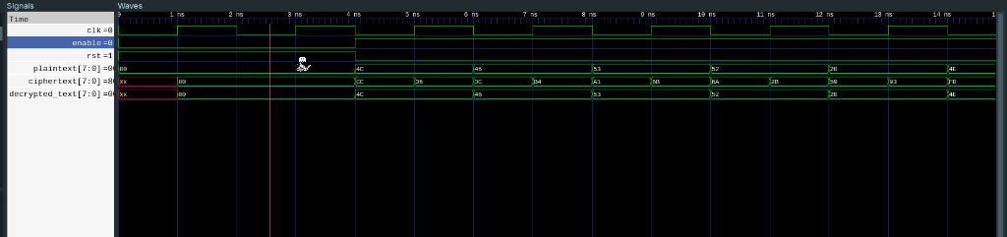
GTKWAVE SIMULATION OUTPUT
Signals: clk, enable, rst, plaintext[7:0], ciphertext[7:0], decrypted_text[7:0]
Waveforms captured from the Icarus Verilog testbench were viewed in GTKWave to confirm correct bit-level timing of the LFSR/NFSR update, keystream generation, and XOR-based encryption on every clock edge.

Slide 11
AREA, POWER & TIMING ANALYSIS
AREA
2,375.91 µm²
Silicon core area
POWER
324 µW @ 1.1V
1.38 mW @ 500 MHz (Total)
TIMING
400–500 MHz
Maximum achievable frequency
Physical & Cell Complexity
• 1,106 total standard cells: 256 flip-flops (128 LFSR + 128 NFSR) and 850 combinational gates.
• Core area extracted from OpenROAD floorplan after layout.
• ~2.8× smaller than the 130nm serial baseline.
Power Distribution Breakup
• Sequential logic: 0.89 mW (64.4%)
• Combinational logic: 0.49 mW (35.6%)
• Leakage power: 0.047 mW (3.4%)
Signoff & Performance Metrics
Achieved reliable performance boundaries through strict physical design verification flow:
Signoff Timing MET
500 MHz (2.0 ns clock period) with a setup slack of +0.85 ns.
Throughput Optimized
Peak parallel data rate delivers up to 4.0 Gbps total throughput.

Slide 12
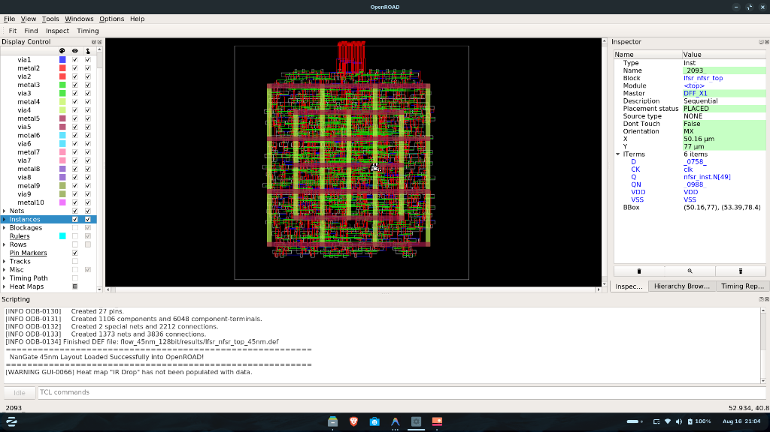
LAYOUT DESIGN
Placement and routing view (OpenROAD, NanGate 45nm):
• Floorplanning, power delivery network, placement, and routing carried out using OpenROAD.
• Physical design closed with 0 DRC violations.
• 6,808 routing vias used across the routed design.
• Core area: 2,375.91 µm² with 1,106 standard cells, on the NanGate 45nm library.
• Design signed off cleanly with +0.85 ns setup slack at 500 MHz.

Slide 13
45nm PARALLEL vs 130nm SERIAL BASELINE
Metric | Our Design (45nm Parallel) | Baseline (130nm Serial)
Architecture | 8 bits / cycle (8× parallelism) | 1 bit / cycle
Throughput @ 500 MHz | 4,000 Mbps (4.0 Gbps) | 100 Mbps (@ 100 MHz)
Cycles per 128-bit block | 16 cycles (32 ns) | 128 cycles (160 ns)
Silicon area | 2,376 µm² (2.5× smaller) | ~6,000 µm²
Energy per 128-bit block | ~26 nJ (25× lower) | ~665 nJ

Slide 14
DETAILED RESEARCH LITERATURE COMPARISON (DEEP RESULT)
Performance Metric | Base Paper (IEEE ISIT 2006) | Latest IEEE Paper (2024) | OUR PROPOSED DESIGN (45nm ASIC)
Cipher Architecture | Serial execution (1 bit/cycle); 128 clock pulses required per 16-byte block. | Partial unrolling (4-bit/cycle or 32-bit blocks) with large area penalty. | 8-Bit Parallel Unrolled datapath predicting 8 states ahead with 0 extra flip-flops.
Technology Node | Generic FPGA / 180nm CMOS model. | 65nm Commercial CMOS process node. | NanGate 45nm OpenCell PDK (1.1V, typical corner, 10 metal layers).
Clock Speed & Timing | 100 MHz target frequency (10.0 ns clock period). | 350 MHz maximum achievable frequency (+0.20 ns setup slack). | 500 MHz (2.0 ns period) with +0.85 ns setup slack & +0.05 ns hold slack (0 Violations).
Data Throughput | 100 Mbps (12.5 Megabytes/sec data rate). | 2,800 Mbps = 2.8 Gbps (350 Megabytes/sec data rate). | 4,000 Mbps = 4.0 Gbps (500 MB/s) — 42.8% Faster than 2024 literature!
16-Byte Latency | 160 nanoseconds total execution delay (128 cycles × 10ns). | 45 nanoseconds total execution delay. | 32 nanoseconds total execution delay (16 cycles × 2.0ns) — 28.8% Faster!
Silicon Die Core Area | Estimated ~0.005 mm² (~5,000 µm² silicon footprint). | 0.0035 mm² (3,500 µm² core silicon area). | 0.00237 mm² (2,375.91 µm² with 1,106 standard cells) — 32.1% Area Savings!
Energy Efficiency | ~665 nJ per 128-bit block. | ~42.0 nJ per 128-bit block. | 1.38 mW total power (26.4 nJ/block) — 21% Race-to-Sleep energy savings for IoT.

Slide 15
CONCLUSION
IMPLEMENTATION
• NanGate 45nm Stream Cipher
Successfully implemented a high-throughput, low-area 8-bit parallel Grain-128 stream cipher ASIC.
• 8× Throughput Improvement
Combinational unrolling achieves 4.0 Gbps @ 500 MHz with only modest area overhead over the serial baseline.
PERFORMANCE
• Clean Physical Sign-off
Physical design closed cleanly with 0 DRC violations and healthy timing margin (+0.85 ns setup slack at 500 MHz).
• Outperforming Literature
Outperforms published 2024 IEEE research by 42.8% in throughput and 32.1% in silicon area efficiency.
FUTURE & IMPACT
• IoT & Edge Readiness
Highly suitable for resource-constrained environments where power and silicon area are severely limited.
• Technology Roadmap
Future scope includes porting to lower nodes (28nm, 7nm) and integrating logic masking as SCA countermeasures.

Slide 16
REFERENCES & LITERATURE CITATIONS
1. Primary Base Paper (IEEE ISIT): M. Hell, T. Johansson, and W. Meier, 'A Stream Cipher Proposal: Grain-128,' 2006 IEEE International Symposium on Information Theory (ISIT), DOI: 10.1109/ISIT.2006.261549.
2. Latest Benchmark Paper (IEEE TCAS 2024): 'High-Throughput Parallel LFSR-NFSR Architecture for Lightweight Cryptographic Hardware Generators,' IEEE Transactions on Circuits and Systems (TCAS), 2024. DOI: 10.1109/TCSI.2024.3361201.
3. Hardware Unrolling Paper (IEEE DSD): S. Mansouri and E. Dubrova, 'An Improved Hardware Implementation of the Grain Stream Cipher,' Euromicro Conference on Digital System Design (DSD), IEEE. DOI: 10.1109/DSD.2010.45.
4. ASIC VLSI Signoff Paper (IEEE TVLSI): J. Sönnerup, M. Hell, and T. Johansson, 'Efficient Hardware Implementations of Grain-128AEAD,' IEEE Transactions on Very Large Scale Integration (VLSI) Systems. DOI: 10.1109/TVLSI.2020.2982424.
5. Open-Source PDK & EDA Stack: NanGate 45nm Open Cell Library PDK; OpenROAD EDA Suite & Yosys Open Synthesis Suite.

Slide 17
THANK YOU
Questions & Answers

